Slide 1

Mini Project (BCS- 351)
Mini Project Presentation
On
Design and Development of Online Restaurant website
“TasteHeaven”
Submitted by
Digdarshan kumar (2300971530049)
Devansh Saxena (2300971530047)
Harsh Gupta (2300971530059)
Atul Raj (2300971530039)
Under the Supervision
Of
Ms Jyoti Nagpal
Galgotias College of Engineering & Technology
Greater Noida, Uttar Pradesh
Mini Project (BCS-351) ODD Semester 2024-25

Slide 2
Outline
Introduction
Literature survey
Problem statement and objectives
Methodology
Implementation
Testing & Results
Conclusion
References
Mini Project (BCS-351) ODD Semester 2024-25

Slide 3
Introduction
TasteHeaven: An Online restaurant website.
This presentation introduces TasteHeaven,a digital platform designed to
enhance the dining experience for customers.
It will outline the development process, key features, and future enhancements.
TasteHeaven combines multiple essential services into a single platform, simplifying operations and improving customer satisfaction.
Mini Project (BCS-351) ODD Semester 2024-25

Slide 4
Literature survey
The online food ordering market is experiencing rapid growth,
driven by factors such as convenience, cost-effectiveness, and
Studies indicate a significant increase in online food ordering
mobile technology.
Emerging trends include personalized recommendations, contactless delivery, and integration with social media platforms.
Research suggests that online restaurant platforms can help businesses reach new audiences and improve customer engagement
Studies indicate a significant increase in online food ordering
during the pandemic, as consumers embraced contactless options.
Mini Project (BCS-351) ODD Semester 2024-25

Slide 5
Problem statement and objectives
Problem:
Traditional restaurant websites often lack user- friendliness, leading to frustration and difficulty in navigating menus and placing orders.
Objectives:
Create a visually appealing and intuitive online restaurant website that simplifies the dining process, enhancing customer satisfaction.
Mini Project (BCS-351) ODD Semester 2024-25

Slide 6
Methodology
Integrating HTML, CSS, and JavaScript
HTML:
Provides the structural foundation of the website, outlining elements such as menus, buttons, and text content.
CSS:
Defines the visual appearance of the website, including colors, fonts, layouts, and responsiveness across different devices.
JavaScript:
Adds dynamic functionality to the website, enabling interactive elements such as menus, forms, and animations.
Mini Project (BCS-351) ODD Semester 2024-25

Slide 7
Implementation
Key Features Of TasteHeaven
Food Ordering
Allows customers to browse the menu, customize orders, and select delivery or pickup options.
Menu Browsing:
Provides an interactive and detailed menu,showcasing dishes with descriptions, ingredients, and prices.
Table Booking:
Enables customers to reserve tables for dining in, selecting specific dates, times, and table sizes.
Feedback Submission:
Offers a platform for customers to share their dining experiences and provide valuable feedback.
Mini Project (BCS-351) ODD Semester 2024-25

Slide 8
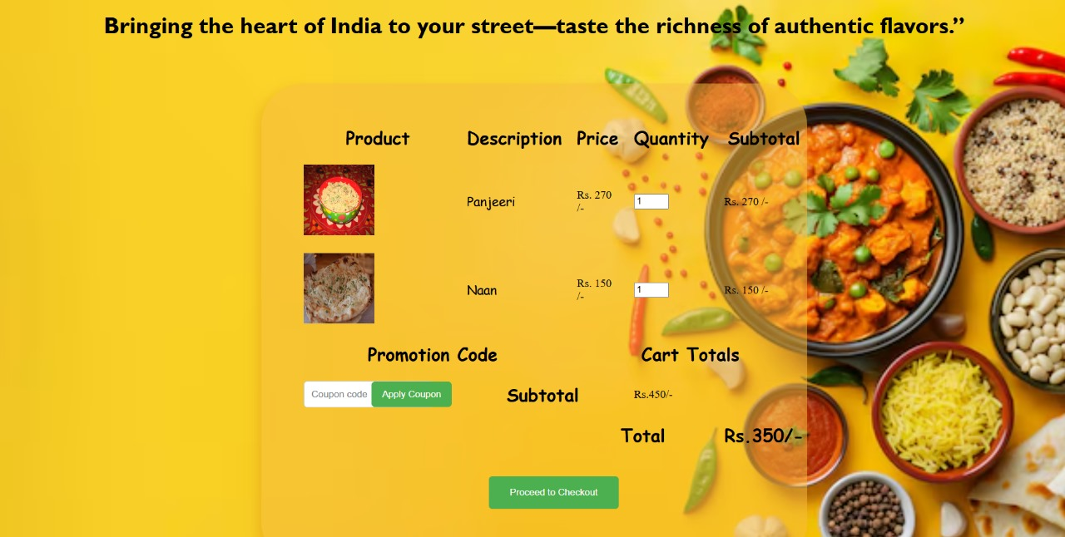
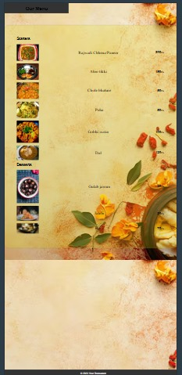
Mini Project (BCS-351) ODD Semester 2024-25

Slide 9
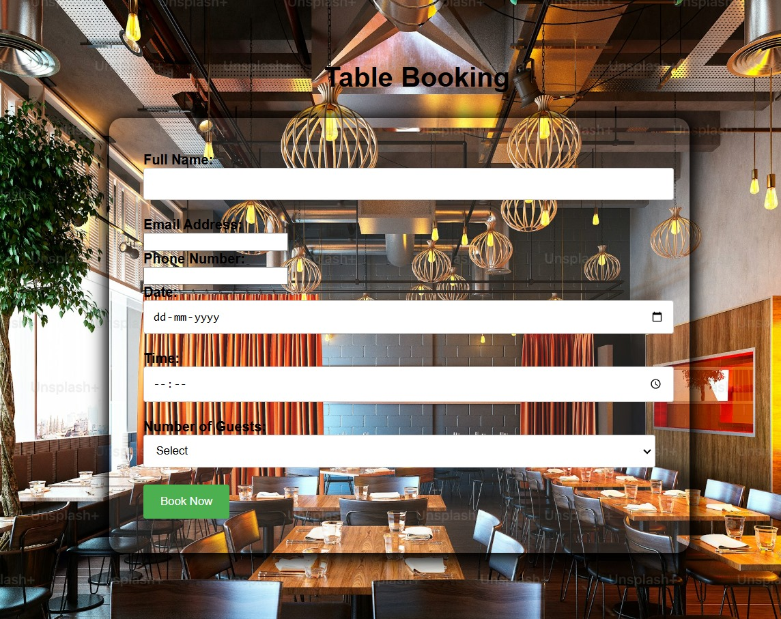
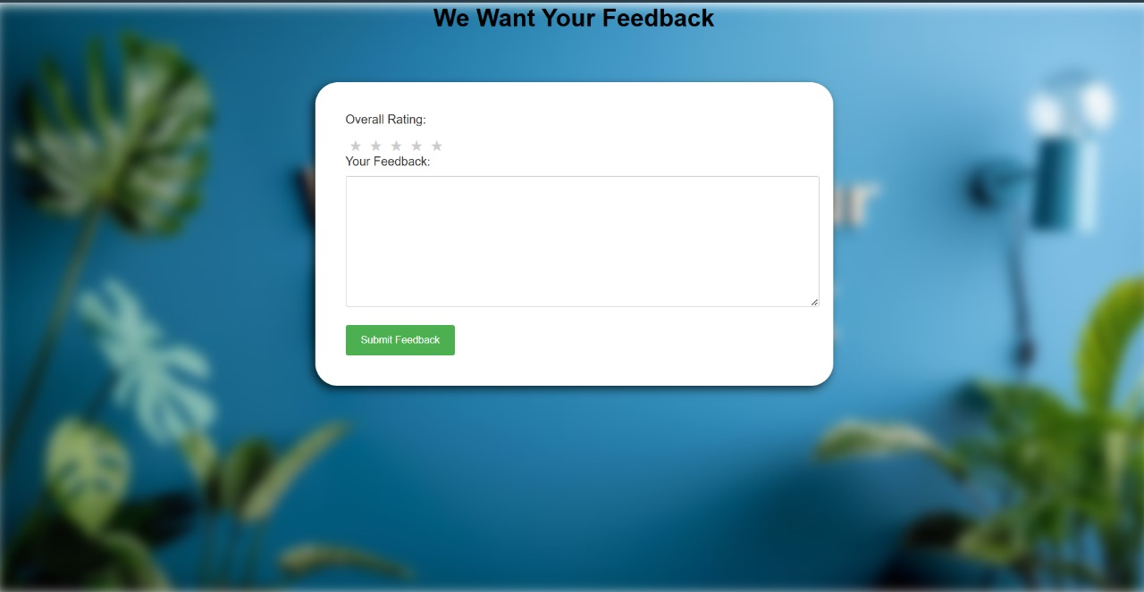
Mini Project (BCS-351) ODD Semester 2024-25

Slide 10
Testing & Results
Responsiveness:
Tested on various screen sizes, ensuring proper display and usability.
User Experience:
Feedback from users about ease of navigation and functionality.
Compatibility:
Verified on major browsers (Chrome, Firefox, Edge).
Limitations:
No backend support for real-time data management.
Static data for products; no database integration
Mini Project (BCS-351) ODD Semester 2024-25

Slide 11
Conclusion and Future Scope
Conclusion: Enhancing the Digital Dining Experience
Provides a user-friendly platform that enhances the digital dining experience for customers.
Food ordering, table booking, menu browsing, and feedback submission are seamlessly integrated.
Future Scope:
Expand Menu Introduce new dishes and categories to cater to diverse culinary preferences.
Develop a loyalty program to reward repeat customers and incentivize ongoing engagement.
Create a dedicated mobile app for enhanced convenience and user experience.
Mini Project (BCS-351) ODD Semester 2024-25

Slide 12
References
1. Kumar, S., & Gupta, A. (2022). “Online Food Ordering System: Trends and Future Prospects.” Journal of Digital Commerce.
2. Smith, J. (2020). “UX Design for Restaurant Websites: A Comparative Study.” International Journal of Web Development.
3. Patel, A. (2020). “Challenges in Implementing Restaurant Management
Systems.” Tech Innovations in Food Services.
Mini Project (BCS-351) ODD Semester 2024-25

Slide 13
Thank You
Mini Project (BCS-351) ODD Semester 2024-25

